Slide 1
Huff Research Group Kendra Andersen
Group Meeting 11/27/17

Slide 2
Project Description
Navigation in Radio Frequency Landscapes using Autonomous Vehicles and Multiple Antenna Systems
Collect data on signal strength of various antenna systems using autonomous rovers.
Develop algorithm to plan a route for the rover which maximizes received signal strength (RSS).
Develop control strategy to examine signal strength at various frequencies for a GPS location and determine the best antenna configuration to maximize RSS.

Slide 3
Question:
What are we doing about public presentations?
URS Symposium on Feb. 28th (oral or poster presentations)
Student Research Week in late March (oral or poster presentations)
Presentation Report is due April 2.

Slide 4
Status
Last Week:
Coming up:
Tested Dijkstra’s algorithm on a hash layout.
Implemented max/min functionality using SNR ratios.
Continue algorithm development to broaden its scope and automate graph creation.
Update the path-planning algorithm to use real data and to determine optimal paths in real-time.
Assist Ryan in collecting data.

Slide 5
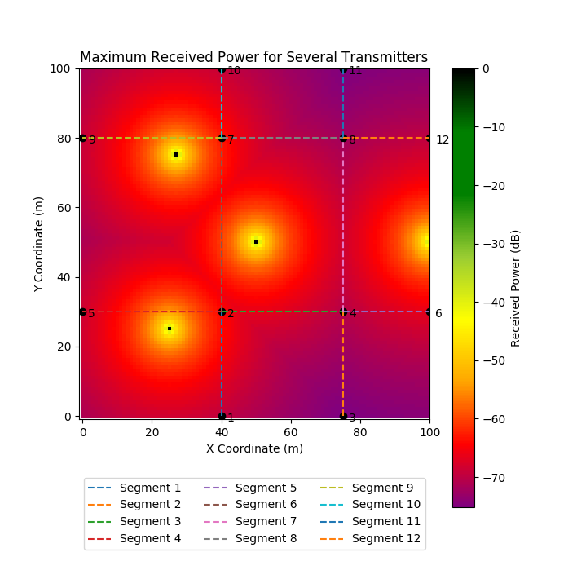
Findings/Progress Applying Dijkstra’s to a hash layout
EXAMPLE 1
Sample Output:
Path from Node 1 to Node 11 maximizing transmitter at [25,25]:
Path: [1, 2, 7, 8, 11]
Cost: 9729.8286542
Path from Node 1 to Node 11 maximizing transmitter at [100,50]:
Path: [1, 2, 4, 8, 11]
Cost: 9832.27109831

Slide 6
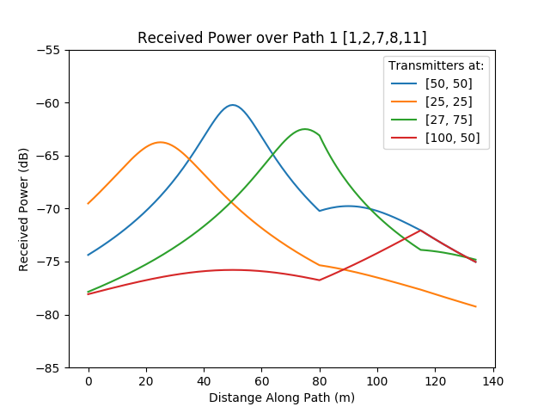
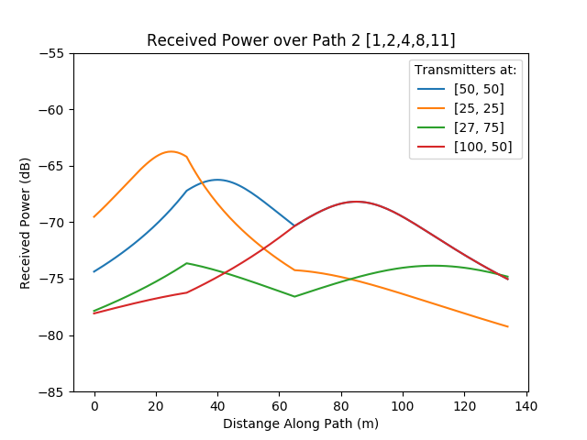
Findings/Progress

Slide 7
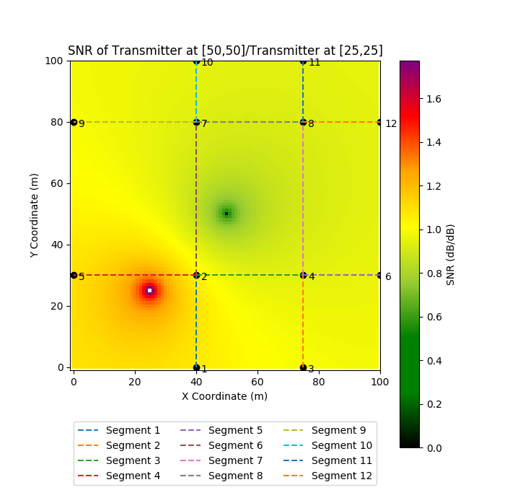
Findings/Progress Applying Dijkstra’s to a hash layout
EXAMPLE 2
Sample Output:
Path from Node 1 to Node 11 maximizing SNR of [50,50]/[25,25]:
Path: [1, 2, 7, 8, 11]
Cost: 129.429901407
(Path 1)

Slide 8
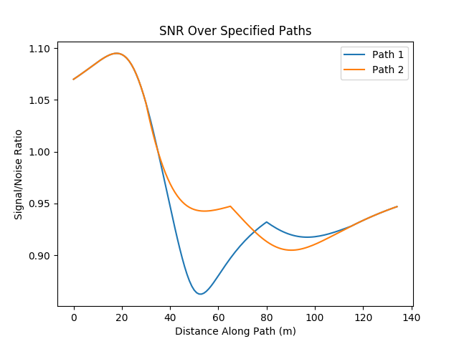
Findings/Progress
SNR of [50,50] to [25,25]
This graph was produced in order to check the answer generated by Dijkstra’s algorithm.
The cost function implemented essentially takes the integral over the curve to the right to choose between paths, trying to minimize the area.

Slide 9
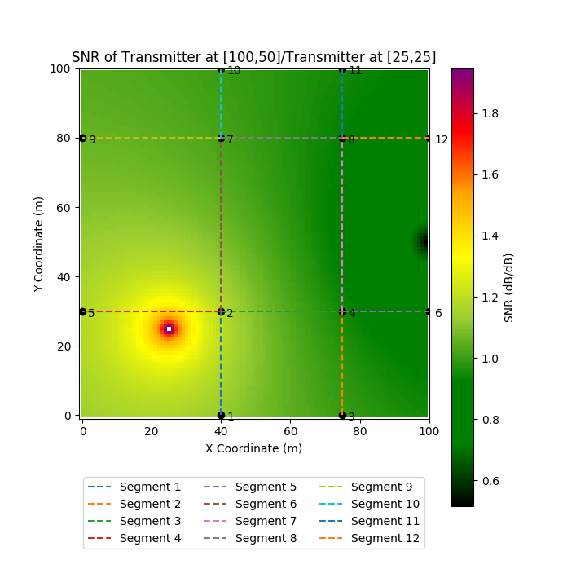
Findings/Progress Applying Dijkstra’s to a hash layout
EXAMPLE 3
Sample Output:
Path from Node 1 to Node 11 maximizing SNR of [100,50]/[25,25]:
Path: [1, 2, 4, 8, 11]
Cost: 136.674239588
(Path 2)

Slide 10
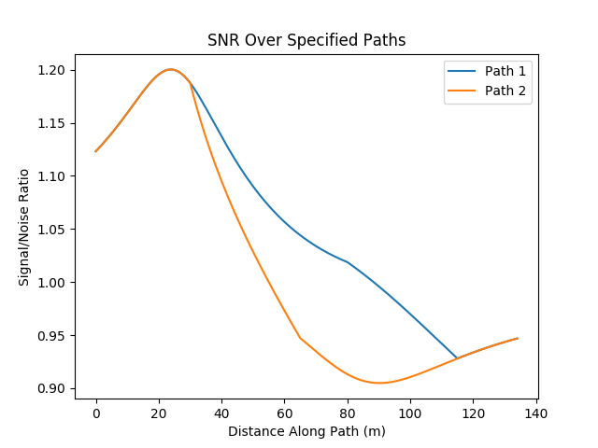
Findings/Progress
SNR of [100,50] to [25,25]
This graph was produced in order to check the answer generated by Dijkstra’s algorithm.
The cost function implemented essentially takes the integral over the curve to the right to choose between paths, trying to minimize the area.

